Slide 1
7x7x7
Paraphrasing Method
Lesson Materials
Supporting Documents:
Social Media Paraphrase 7x7x7 Student
Janice GT Penner
pennerj@douglascollege.ca
www.AACE-English.com

Slide 2
Session Overview
Determine the 7 step process
  Review “thought groups”
Review 7 paraphrase strategies
Identify good and poor paraphrases
Apply the Strategies
Highlight 7 other aspects
All tasks will relate to social media

Slide 3
Paraphrasing Skills Preview
Discuss with a partner & put notes on your handout:
What is paraphrasing?
When do we paraphrase?
Why do we paraphrase?
How do we paraphrase?
List at least 7 strategies for “how”

Slide 4

Topic Preview:
Make a list of social media sites you and your friends use
Source: www.flickr.com/mkhmarketing/8539048913
/

Slide 5
Discuss the questions on the handout
What are some advantages of using social media?
What are some disadvantages of social media use?

Slide 6
7 Steps of Paraphrasing Put these steps in order
___ Compare the original with your paraphrase
___ Recognize source (in bracket/sentence)
__1_Be sure you understand the text and that it suits your purpose
___ Break the sentences into meaningful thought groups (AKA grammatical chunks)
___ Change the wording (see 7 strategies)
___ Cross out unnecessary info/details
___ Circle the key words/ specific vocabulary for the topic

Slide 7
Answers: 7 possible Paraphrasing Steps
_6 Compare the original with your paraphrase
_7 Recognize source (in bracket/sentence)
_1_Be sure you understand the text and that it suits your purpose
_4_ Break the sentences into meaningful thought groups (AKA grammatical chunks)
_5_ Change the wording (see 7 strategies)
_2_ Cross out unnecessary info/details
_3_ Circle the key words/ specific vocabulary for the topic

Slide 8
Review: Thought Groups
Discuss:
What are thought groups?
How are they connected to paraphrasing?

Slide 9
TG = set of words connected by grammar or meaning.
The English essay was confusing because the student used Google Translate.
The English essay which described the benefits of phrase-based machine translation (PBMT) confused the reader because the international student used Google Translate.
The five page English language essay which argued for the benefits of phrase-based machine translation (PBMT) confused the professor because the French speaking international Info Tech student used Google Translate, a free app used by many language learners.

Slide 10
Thought Group Task:
Task: Excerpt from “Background Social Networking” (ProCon.org, 2018)
Read the sentences and put a slash (/) where you think each thought group ends.
Some of the punctuation has been deleted
To help you, read out loud.

Slide 11
Examples of thought groups
Around seven out of ten Americans/ use social networking sites/ such as Facebook/ Instagram/ Twitter/ LinkedIn and Pinterest/ as of 2018/ up from 26% in 2008.
On social media sites/ users may develop biographical profiles/ communicate with friends and strangers/ do research/ and share thoughts/ photos, music, links and more.
What do you notice about TG?

Slide 12
There are 2 sentences left in this excerpt.
Put slashes to show Thought Groups

Slide 13
Suggested Thought Groups source: Background Social Networking, ProCon.org, 2018a)
Proponents of social networking sites say that / the online communities promote increased interaction with friends and family/ offer teachers librarians and students - / - valuable access to educational support and materials / facilitate social and political change /and disseminate useful information rapidly.

Slide 14
Opponents of social networking say / that the sites prevent face-to-face communication/ waste time on frivolous activity/ alter children’s brains and behavior/ making them more prone to ADHD/ expose users to predators like pedophiles and burglars/ and spread false and potentially dangerous information.

Slide 15
Step: Cross out unnecessary details
Imagine you are writing an opinion/ argument essay about social media.
Which details could you keep from this source above?
Which details are repeated or unnecessary?

Slide 16
Ex: unnecessary info for an argument essay
Around seven out of ten Americans use social networking sites such as Facebook, Instagram, Twitter, LinkedIn and Pinterest as of 2018, up from 26% in 2008. On social media sites users may develop biographical profiles, communicate with friends and strangers, do research, and share thoughts, photos, music, links and more.
Proponents of social networking sites say that the online communities promote increased interaction with friends and family, offer teachers librarians and students valuable access to educational support and materials, facilitate social and political change, and disseminate useful information rapidly.
Opponents of social networking say that the sites prevent face-to-face communication, waste time on frivolous activity, alter children’s brains and behavior making them more prone to ADHD, expose users to predators like pedophiles and burglars, and spread false and potentially dangerous information.

Slide 17
Ex: Circle/ Select Key words
Around seven out of ten Americans use social networking sites such as Facebook, Instagram, Twitter, LinkedIn and Pinterest as of 2018, up from 26% in 2008. On social media sites users may develop biographical profiles, communicate with friends and strangers, do research, and share thoughts, photos, music, links and more.
Proponents of social networking sites say that the online communities promote increased interaction with friends and family, offer teachers librarians and students valuable access to educational support and materials, facilitate social and political change, and disseminate useful information rapidly.
Opponents of social networking say that the sites prevent face-to-face communication, waste time on frivolous activity, alter children’s brains and behavior making them more prone to ADHD, expose users to predators like pedophiles and burglars, and spread false and potentially dangerous information.

Slide 18
7 Common Strategies: Description
Refer to handout:
7 Strategies for Paraphrasing: Description
Read the original article first (left column)
Then, read the original with the paraphrase
  The bold faced words highlight the strategy.
  The underlined words are KEY WORDS that needn’t be changed.
Adapted Source: ProCon.org, (2018, August 17) Top Pro & Con Arguments: Social Networking, retrieved from https://socialnetworking.procon.org

Slide 19
Vital step:
To reinforce the concept of Thought Groups and help you paraphrase, use colors to identify the thought groups in both example sentences.
The first one on your handout has been done for you.

Slide 20
Student Handout excerpt 7 Strategies: Description
Example: Notice the strategy (bold on handout) underlining → shows key words colors & / → show thought groups
Change the idea into an opposite one
Original
“A survey by/ the International Association of Chiefs of Police/ found that 85%/ of police departments /use social media to solve crimes” (ProCon.org, 2018b).
Paraphrase
Fifteen percent /of police forces/ do not solve crimes using social media /according to survey results/ by the International Association of Chiefs of Police (Procon.org, 2018b).

Slide 21
Identifying Strategies
Read the original and put slashes (/) to identify the Thought Groups.
Read the Paraphrase
Identify and list which strategies were used.
If possible on your own handout, use color to help you analyze the two texts.
Students work on hard copy. For debriefing, the suggested analysis follows each slide.

Slide 22
Identifying Strategies Example
Original “A study in the journal Science / found that lies spread /six times faster than the truth on Twitter, / and “fake news”/ is retweeted more often than true news” (ProCon.org, 2018b).
Paraphrase On Twitter, true news is retweeted less than “fake news” and untrue information is distributed six times faster than true information , according to research reported in the Science journal (ProCon.org, 2018 b).

Slide 23
Example Suggested Analysis
Changed order of ideas
Twitter / research source info /
  Changed into opposite
  Fake news – retweeted MORE → true news – retweeted LESS
  Word form
  the truth → true information
  Synonyms
  A study → research
  Q: The phrase six times faster than is used in the paraphrase.
  Is this plagiarism? Can this expression be avoided?

Slide 24
1. Identifying Strategies
Original “The National Security Agency (NSA) can monitor social media activity and read the content of private social media messages simply by entering a person’s username into their system” (ProCon.org, 2018b)
Paraphrase When an individual’s username is entered into the National Security Agency’s system, his/her social media content can be read and how often they use it can be noted (ProCon.org, 2018b).

Slide 25
1. Suggested Analysis
Original “The National Security Agency (NSA) can monitor social media activity and read the content of private social media messages simply by entering a person’s username into their system” (ProCon.org, 2018b)
Paraphrase When an individual’s username is entered into the National Security Agency’s system, his/her social media content can be read and how often they use it can be monitored (ProCon.org, 2018b).
Strategies
Active → passive voice
    Enter / read / noted
order of info
pronouns A person’s → his/ her
made adverb clause → WHEN

Slide 26
2. Identifying Strategies
Original “Gangs use the sites to recruit younger members, coordinate violent crimes, and threaten other gangs” (ProCon.org, 2018b).
Paraphrase Organizing violent criminal actions, finding new gang members and making threats against other criminal groups are three ways gangs use internet sites.

Slide 27
2. Suggested analysis
Original “Gangs use the sites to recruit younger members, coordinate violent crimes, and threaten other gangs” (ProCon.org, 2018b).
Paraphrase Organizing violent criminal actions, finding new gang members and making threats against other criminal groups are three ways gangs use internet sites (ProCon.org, 2018b).
Strategies: Idea order
synonyms coordinate → organizing
word form
  threaten → make threats against
Verb phrase: to recruit … → noun phrase: Organizing … are three ways ..

Slide 28
3. Identifying Strategies
Original “From social media sites, simple algorithms can determine where you live, sexual orientation, personality traits, signs of depression, and alma maters among other information, even if users put none of those data on their social media profiles” (Procon.org, 2018b).
Paraphrase Some people do not put their location, former school, personality, sexual orientation, or depressed feelings on their profiles, but these can be identified through algorithms (ProCon.org, 2018b).

Slide 29
3. Suggested Analysis
Original “From social media sites, simple algorithms can determine where you live, sexual orientation, personality traits, signs of depression, and alma maters among other information, even if users put none of those data on their social media profiles” (Procon.org, 2018b).
Paraphrase Some people do not put their location, former school, personality, sexual orientation, or depressed feelings on their profiles, but it can be figured out by algorithms (ProCon.org, 2018b).
Strategies:
passive – active algorithms can → identified through
synonyms where you live → location, etc
idea order
Transitions Even if → but
Kept sexual orientation → a complex term, hard to change

Slide 30
Evaluating Paraphrases Example
For the example and 3 poor paraphrases:
Thought groups are not shown
Just the possible problems will be shown on the “suggested analysis” slides.

Slide 31
Suggested Analysis - Example
Original “Around seven out of ten Americans use social networking sites such as Facebook, Instagram, Twitter, LinkedIn, and Pinterest, as of 2018, up from 26% in 2008” (ProCon.org, 2018a).
Paraphrase Around seven out of ten Americans use social networking sites. The population of Americans grew 26% from 2008 – 2018.
Problems plagiarized – 4+ words copied
Wrong info – not population grew→ users grew
No source → (ProCon.org, 2018b)
?Important? missed info – “at least 5 kinds of s__m__”

Slide 32
1. Suggested Analysis
Original “On social media sites, users may develop biographical profiles, communicate with friends and strangers, do research, and share thoughts, photos, music, links, and more” (ProCon.org, 2018a).
Paraphrase Users can do plenty of things on social media even communicate with strangers, share the moment, selfies, links and more (ProCon.org, 2018a).
Problems
Order of ideas – too close to the original
Missing info – profiles, friends , research BUT had “and more”
Added/ changed info - selfies – Original used “photos”
What does “share the moment” mean?

Slide 33
2. Suggested Analysis
Original “Proponents of social networking sites say that the online communities promote increased interaction with friends and family; offer teachers, librarians, and students valuable access to educational support and materials; facilitate social and political change; and disseminate useful information rapidly” (ProCon.org, 2018a).
Paraphrase Online communities help to develop interaction with family and friends, provide educational support and materials for teachers, librarians and students, change social and political life as well as give out information quickly and easily according to the supporters of social media sites.
Order of ideas - exact same order
Plagiarism - some parts have 4+ words copied
not enough synonyms
Style? according to – would work better in the front.
No source

Slide 34
3. Suggested Analysis
Original “ Opponents of social networking say that the sites prevent face-to-face communication; waste time on frivolous activity; alter children’s brains and behavior making them more prone to ADHD; expose users to predators like pedophiles and burglars; and spread false and potentially dangerous information (ProCon.org, 2018a)
Paraphrase “A lot of people against the popularity of social networking say that people waste time, brains and behavior is changed, the number of crimes and “fake news” increases” (ProCon.org, 2018 a).
Format: shouldn’t have “ quotation marks”
missed idea - concept of prone to ADHD
Wrong info – opponents – not same meaning as “a lot of”
wrong idea – NOT crimes increases → exposure increases
Added term: fake news – not the same as “false and dangerous” – it’s a special/ key term now

Slide 35
Your Turn #1
Using the strategies, write better paraphrases for these 4 “poor” ones.

Slide 36
Your Turn 2 Option A
Basic vocabulary you need to understand the article: hockey over time a penalty shot
Background
Victoria and Vancouver hosted the 2019 World Junior Hockey Championships. (not professional players yet)
For the first time in the history of these games, the Canadian team did not compete for any medals (gold, silver or bronze).
Why? You will learn from the next article.

Slide 37

Canada’s Maxime Comtois /rests his head on his glove /after missing a penalty shot. / Team Canada lost to Finland / during overtime / in Vancouver on Wednesday, January 2, 2019. I mage source: Global news

Slide 38
So?
How can the topics of hockey and social media be connected?

Slide 39
Option A
Hate against Team Canada captain on social media shines light on athlete abuse online: experts
Reporter: Jessica Vomiero January 4, 2019
National Online Journalist Global news
Refer to handout for paraphrasing task

Slide 40

Option B
How could hockey sticks placed by doorways be connected to Social Media?
Source: ctvnews.ca #SticksOutfor Humboldt

Slide 41
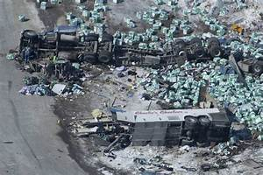
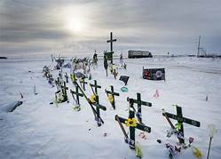
What do you know about April 6, 2018 and the Humboldt Broncos?
Source: theguardianpe.ca source: unknown

Slide 42
Task instructions for A and/or B
It’s unusual to paraphrase an entire article.
This is guided practice.
Read through the article
Choose 6 sets of ideas to paraphrase
Often refer to Summary: 7x7x7 Paraphrasing Method
Format:
    Please type your paraphrase.
Double space.
Indicate the set number you are paraphrasing.

Slide 43
7 x 7 x 7 paraphrasing method
Relax!
Paraphrasing is a complicated skill.
We all learn through extensive practice.
Don’t forget to often refer to the handout:
Summary 7x7x7 Paraphrasing Method

Slide 44
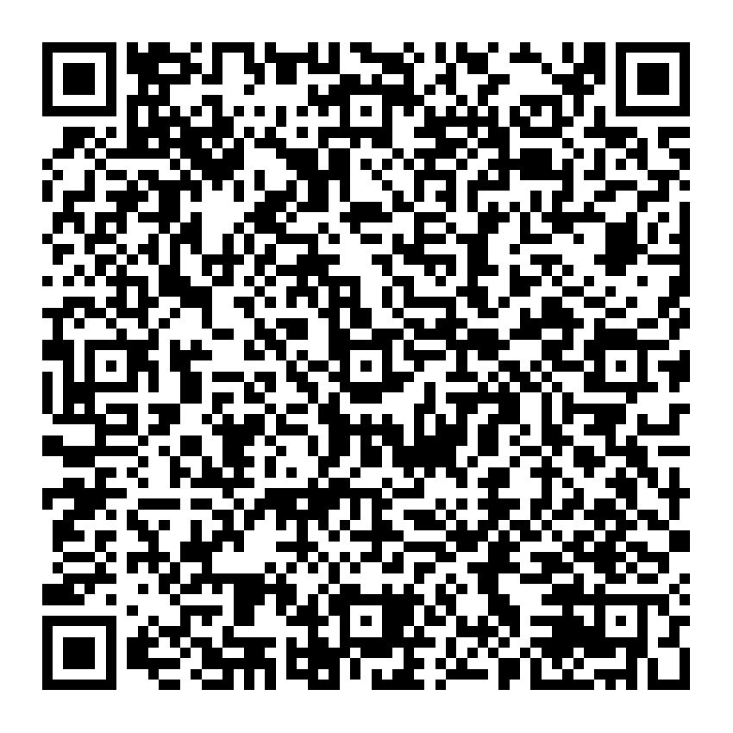
7x7x7 Paraphrasing Method
7 Paraphrase Steps
7 Common Strategies
7 other important aspects
pennerj@douglascollege.ca
www.AACE-English.com

Slide 45
Save the Date!
  2020 Vision
  April 23 – 24 The Image Conference
  April 24 – 25 BC TEAL
  theimageconference.org
  bcteal.org
  Call for Proposals – late Nov

Slide 46


